Slide 1
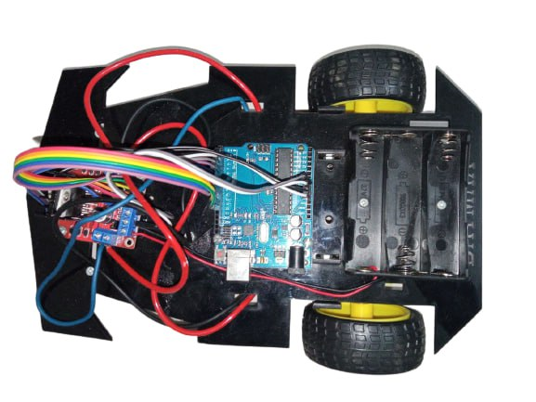
Principal OF Robotics Cse 426
Line Follower ROBOT

Slide 2
Presented By
Sec : C-54
Akin Bin Mostofa kamal 193-15-13394

Slide 3
What is a line follower?
A line follower is a type of robot or vehicle designed to follow a line or path marked on the ground or surface. It is commonly used in robotics competitions, educational settings, and industrial applications.

Slide 4
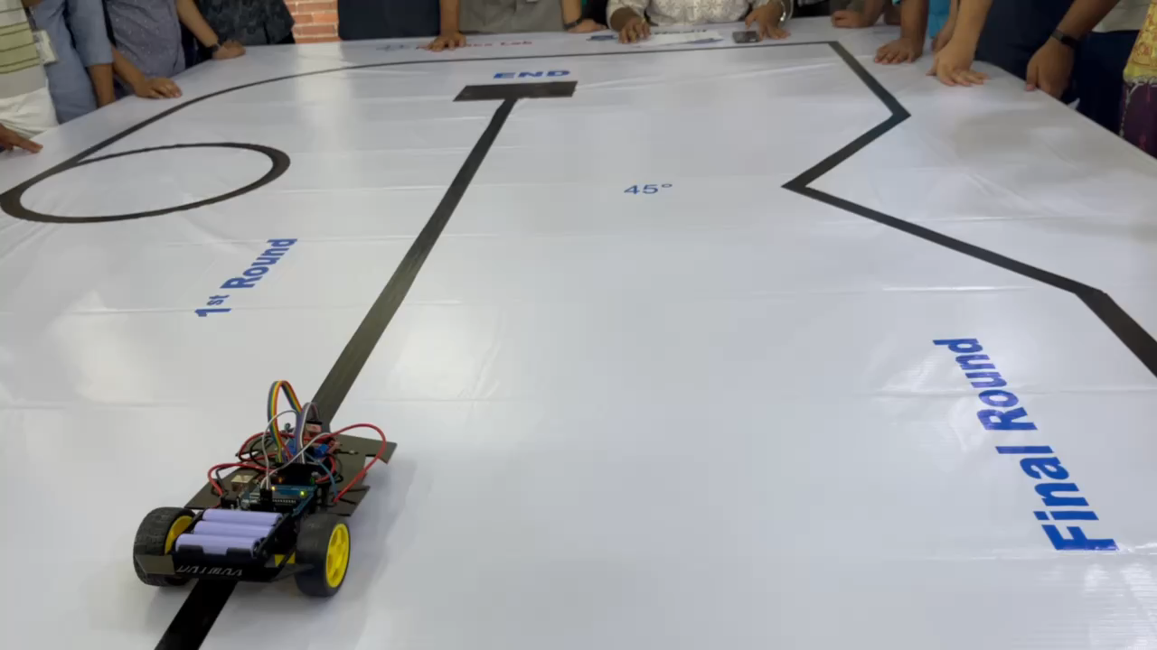
What is the need to build a line follower? Sensing a line and maneuvering the robot to stay on course ,while constantly correcting wrong moves using feedback mechanism forms a simple yet effective closed loop system

Slide 5
Component's of Line Follower Robot
Chassis: The physical structure or body of the robot that holds all the components together. It can be a wheeled platform or any other suitable design.
Line Sensors: These sensors are used to detect the line on the ground. Infrared or reflective sensors are commonly used, which emit and detect light to determine the contrast between the line and the surface.
Microcontroller: The brain of the robot, usually a microcontroller or a microprocessor, which processes sensor data, executes control algorithms, and sends commands to the motor drivers.
Motor Drivers: These electronic components control the speed and direction of the robot's motors based on the signals received from the microcontroller. They translate the commands into motor movements.
Motors: The motors provide the mechanical motion to move the robot. Typically, DC motors are used, with one or more wheels connected to them for propulsion.
Power Source: A power supply, such as batteries or rechargeable batteries, provides electrical energy to the robot to operate its components.
Wheels: The wheels enable the robot to move along the ground or surface. They can be attached to the motors directly or through a suitable mechanism.
Control Algorithm: A program or algorithm implemented in the microcontroller determines how the robot responds to the line sensor inputs. It calculates the appropriate motor commands to keep the robot on the line.
Additional Components: Depending on the specific design and requirements, other components such as LEDs, resistors, capacitors, and switches may be included for status indicators, power regulation, and user interaction.

Slide 6
Implementation of Line Follower Robot
Design and Assembly:
Determine the desired size, shape, and functionality of the robot.
Select a suitable chassis or build one from scratch.
Attach motors, wheels, and line sensors to the chassis.
Connect the necessary electronic components, such as the microcontroller, motor drivers, and power source, according to the chosen design.
Line Sensor Calibration:
Calibrate the line sensors to detect the contrast between the line and the surface.
Adjust the sensitivity of the sensors to ensure accurate detection of the line.
Microcontroller Programming:
Write the code to control the line follower robot's behavior.
Define how the robot responds to different line sensor inputs.
Implement control algorithms to adjust motor speed and direction for line following.
Line Following Algorithm:
Develop an algorithm that interprets the sensor data and determines the robot's movement.
The algorithm can be as simple as "If the left sensor detects the line, turn left; if the right sensor detects the line, turn right," or more advanced techniques like PID control or fuzzy logic.
Motor Control:
Use the programmed microcontroller to send appropriate signals to the motor drivers.
Adjust the motor speed and direction based on the line sensor inputs and the line following algorithm.
Testing and Refinement:
Test the line follower robot on a track with a line.
Observe its performance and make adjustments to the code and hardware if needed.
Fine-tune the line following algorithm and sensor calibration to optimize the robot's accuracy and speed.
Iteration and Improvement:
Iterate the testing, refinement, and adjustment process to improve the line follower's performance.
Experiment with different control strategies, sensor placements, or additional features to enhance the robot's capabilities.

Slide 7
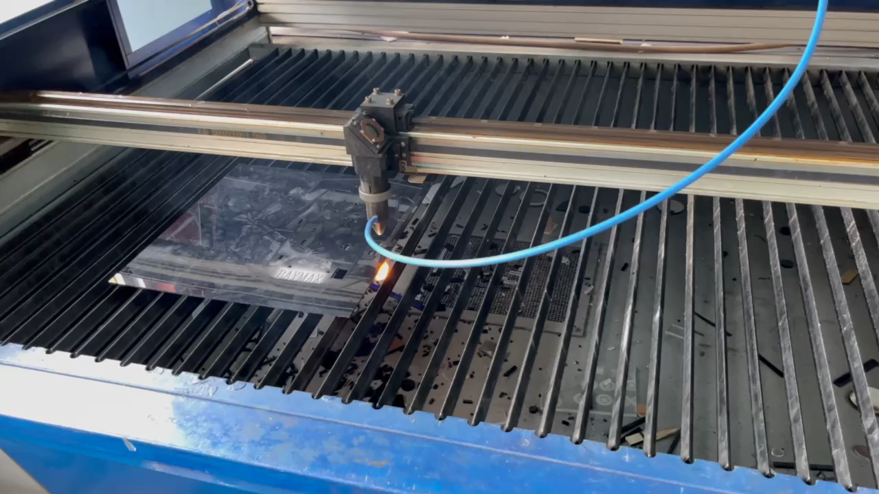
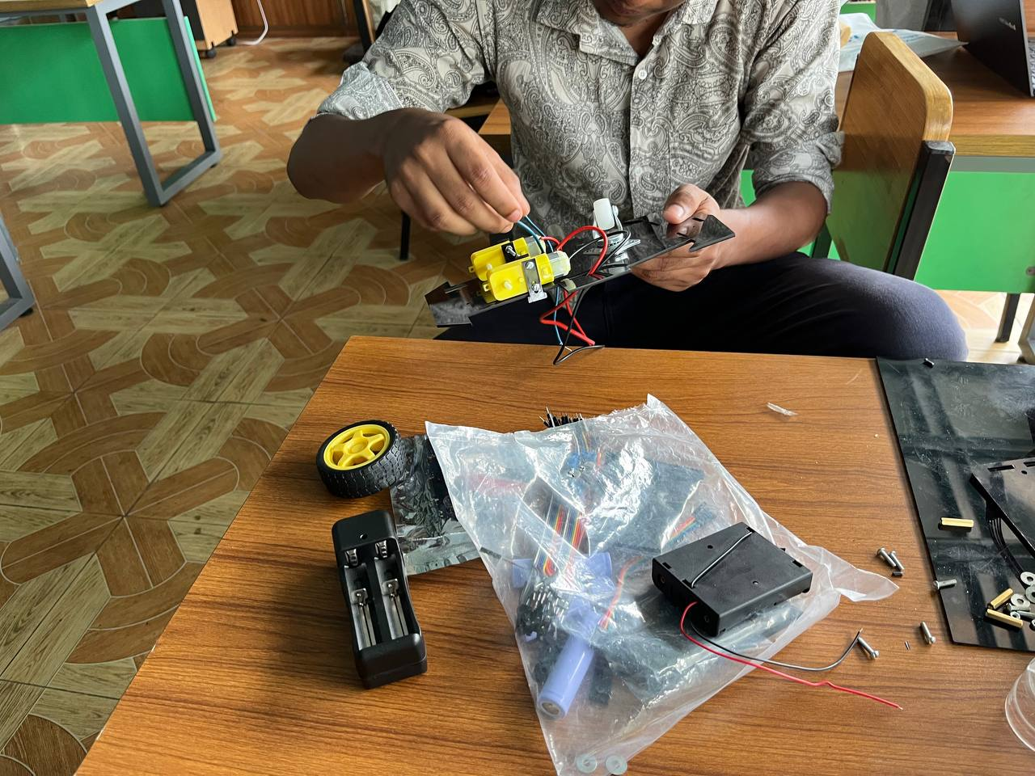
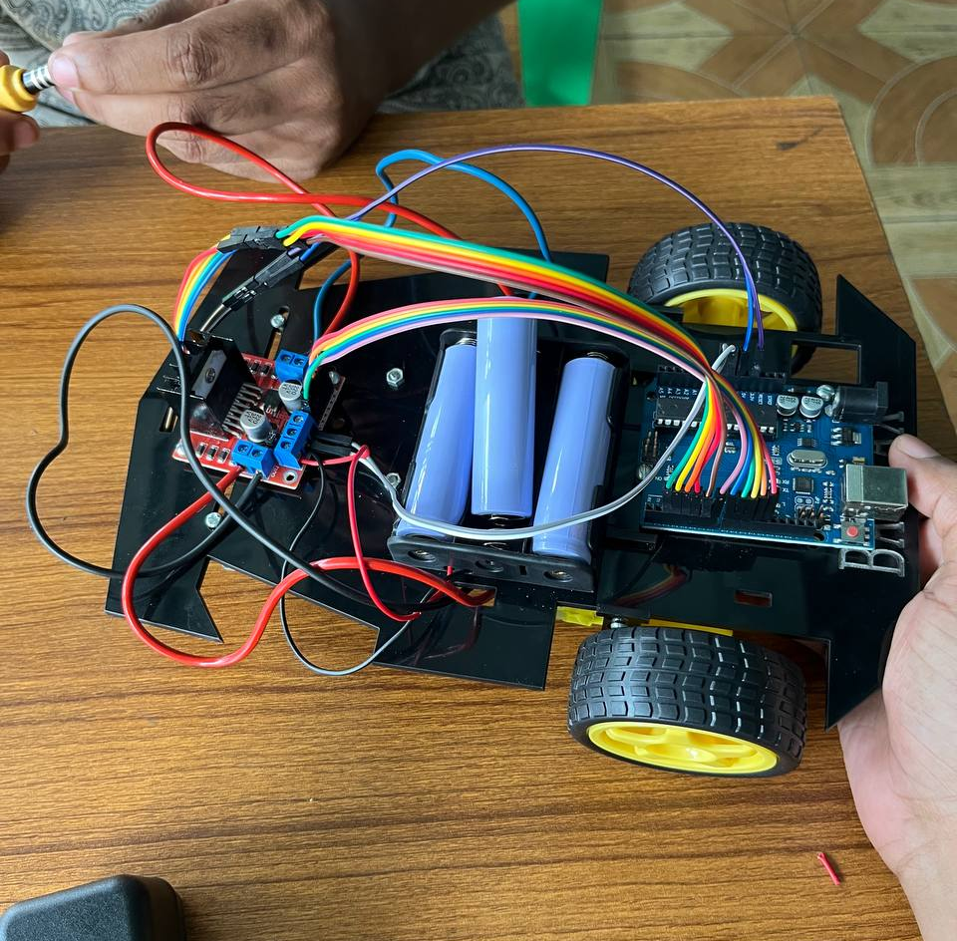
Building and implementation process

Slide 8
Conclusion
Overall, building a line follower robot offers a hands-on experience in robotics, fosters problem-solving skills, promotes creativity, and can serve as a foundation for more complex autonomous systems. Whether for educational purposes, competition, or industrial automation, line followers play a significant role in advancing robotics and automation technology.

Slide 9
Thank You

